Slide 1

INSURANCE ANALYSIS PROJECT
Project Members—
Adarsh Srivastava
Chetana Gawande
Darshan Nikam
Chevarthi Mounika
Shobha
Samba Siva
PROJECT MENTORS
Abirami
Satish

Slide 2
This INSURANCE ANALYTICS dashboard provides an analysis of insurance sales and performance across different categories such as Cross-Sell, New Business, and Renewals. It tracks key performance indicators (KPIs) and achievements against set targets. Our goal is to provide actionable insights into sales trends, evaluate target achievements, and identify both strengths and areas for improvement within the sales funnel The data is segmented by Account Executives, Opportunities by Revenue, and other relevant breakdowns
INTRODUCTION

Slide 3
KPI’S and INSIGHTS
Cross Sell – Target ,Achieve, Invoice
New—Target, Achieve, Invoice
Renewal—Target Achieve, Invoice
Number Of Invoices made by Account Executive
Yearly Meeting Count
Number of meeting by Account Executive
Stage Funnel by Revenue
Top Open opportunities

Slide 4


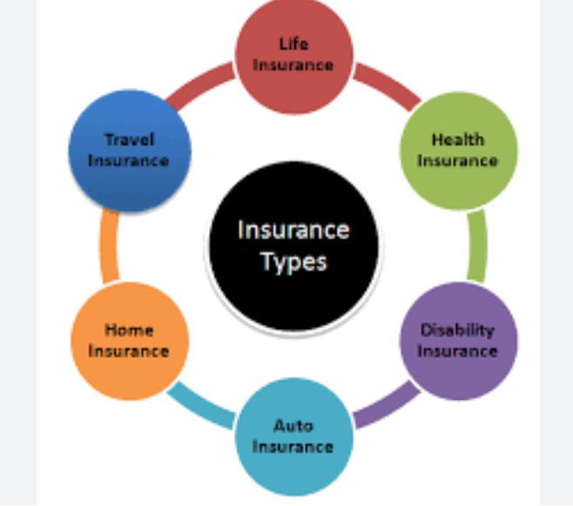
Key Words
Cross-Sell - Cross-selling refers to selling additional insurance products to existing customers
New - New policies sold to first-time customers
Renewal- renewing existing insurance policies.
Open Opportunity
It represents an unclosed sales prospect that is still in progress and has not yet been won or lost

Slide 5
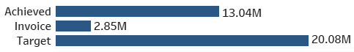
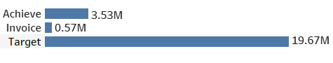
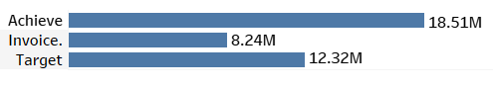
INSIGHTS
Cross-Sell Performance
Achievement: 64.94% of the target has been met, meaning cross-sell efforts are progressing but need improvement.
Invoice Achievement: Only 14.21% of sold policies have been invoiced, indicating delays in finalizing payments.
New Performance
New Placed Achievements: 17.95%, which suggests that only a small portion of potential new business is being converted.
New Invoice Achievement: 2.90%, a very low number indicating slow policy finalization
Renewal Performance
Renewal Achievement: 150.23%, exceeding the target, which is a strong indicator of customer retention.
Renewal Invoice Achievement: 66.92%, showing a good but improvable invoicing rate.

Slide 6
Target vs. Achieved: Displays how much of the cross-sell goal has been met.
Cross-Sell Invoice Achievement: Shows the percentage of invoiced policies compared to targets.
Renewal Placed Achievement – Percentage of successfully renewed policies.
Renewal Invoice Achievement – Percentage of renewed policies that have been invoiced.
New Placed Achievements: Measures the percentage of successfully closed deals.
New Invoice Achievement: Tracks the percentage of invoiced policies
Account Executive Performance:Tracks the performance of different Account Executives in terms of customer interactions and revenue contribution.
Number of Meetings by Account Executive – Highlights the engagement levels of different executives.
Stage Funnel by Revenue – Breaks down sales opportunities by revenue stage (Qualified, Negotiation, Process Solution)
This dashboard provides clear insights into sales performance, executive productivity, and revenue trends. While renewals are strong, cross-sell and new business require strategic improvements, especially in invoicing and finalizing sales. By addressing these gaps, the company can enhance overall profitability and efficiency.

Slide 7

Account Executive Performance
Tracks the number of meetings held by different executives.
Some executives are engaging more customers, while others may need coaching or better lead distribution.
This Photo by Unknown Author is licensed under CC BY-SA-NC
Opportunities by Revenue
Displays top revenue-generating insurance products, such as Fire, Employee Benefits, and Group Medical Insurance.
Helps prioritize high-value deals and focus efforts on the most profitable areas

Slide 8

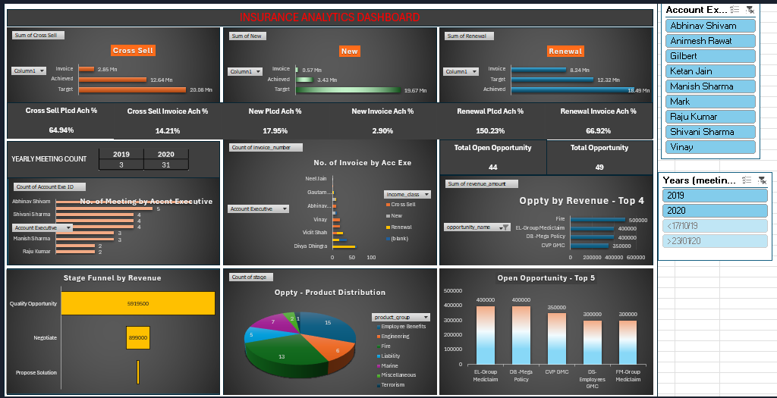
EXCEL DASHBOARD

Slide 9
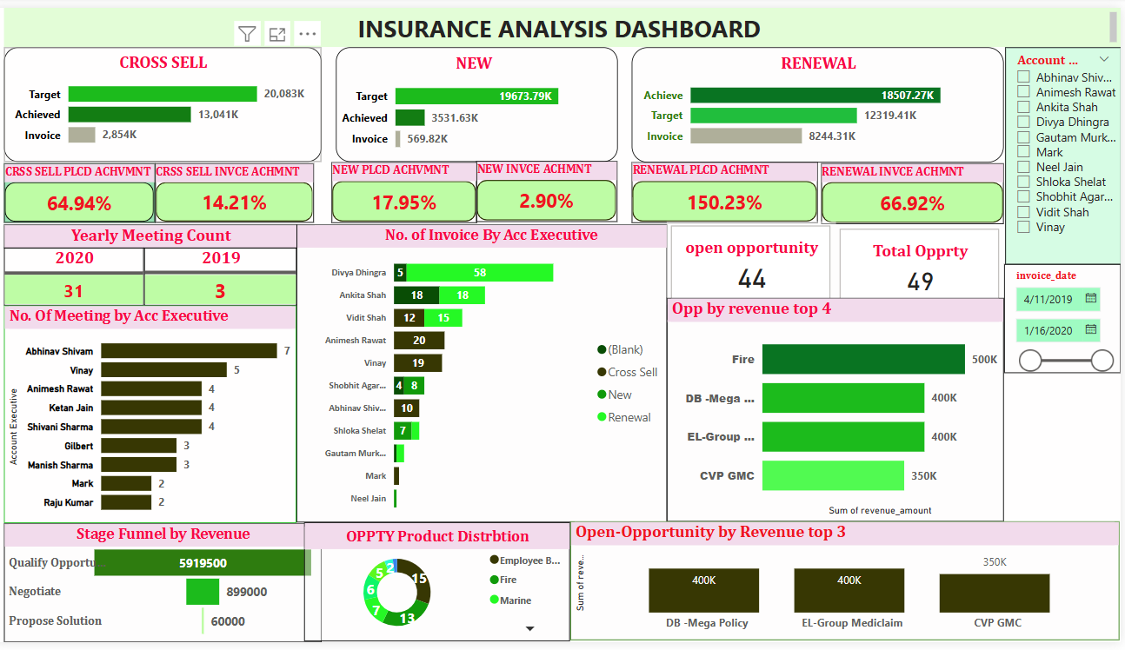
POWER BI DASHBOARD

Slide 10

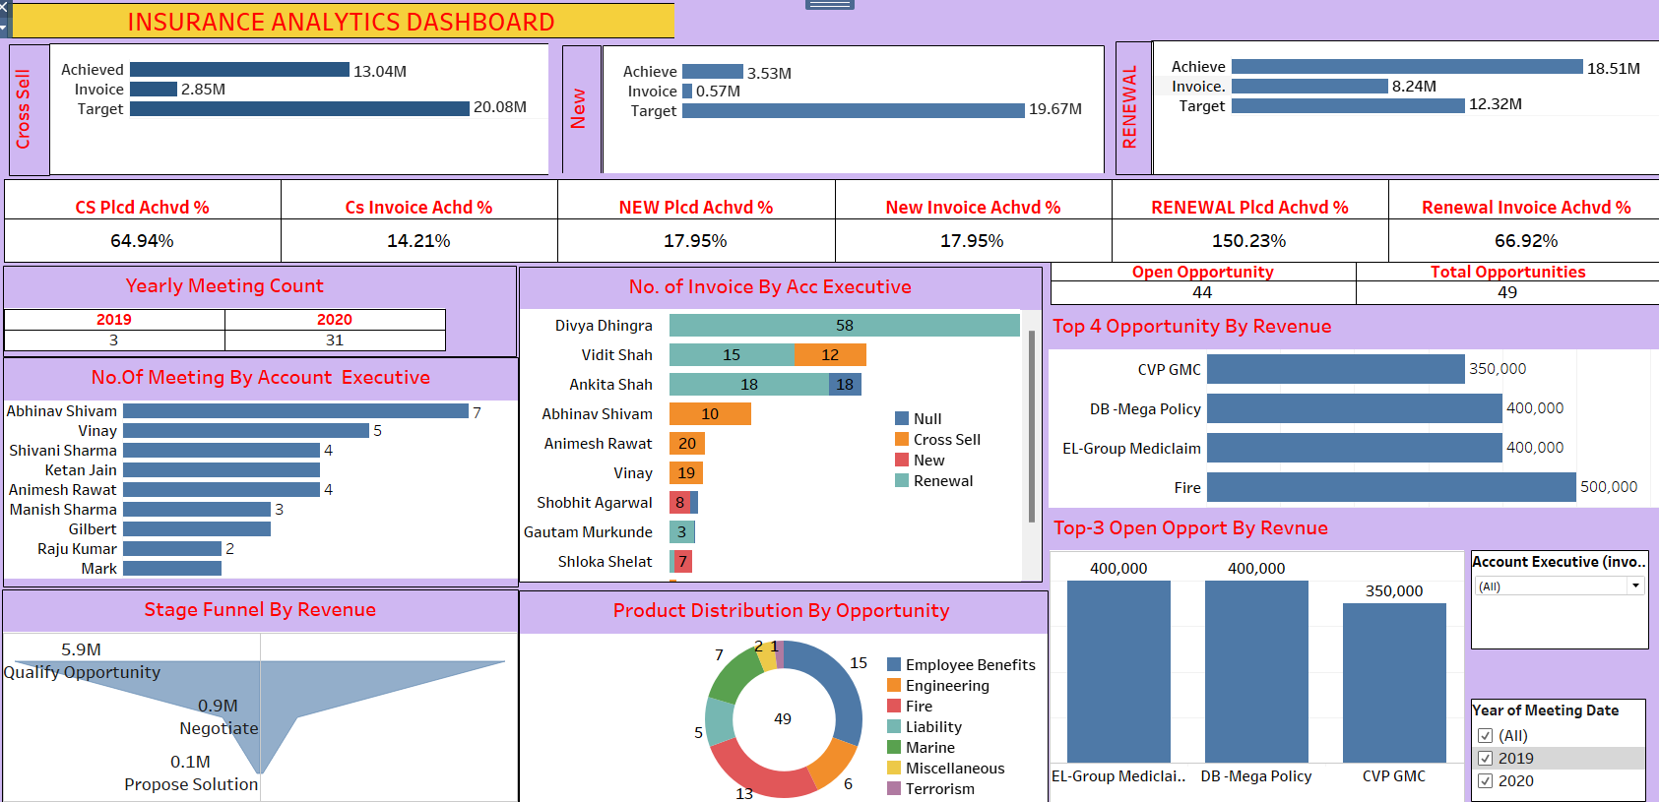
TABLEAU DASHBOARD

Slide 11

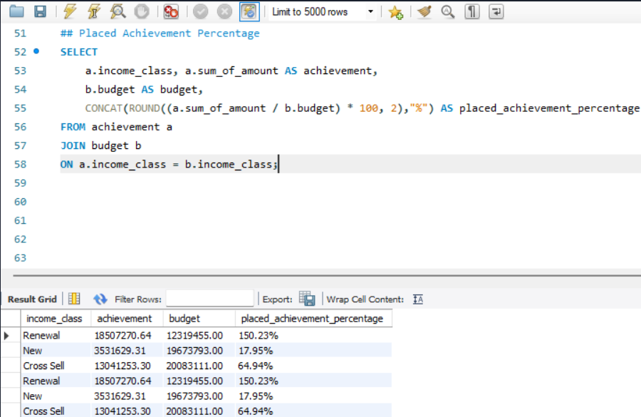
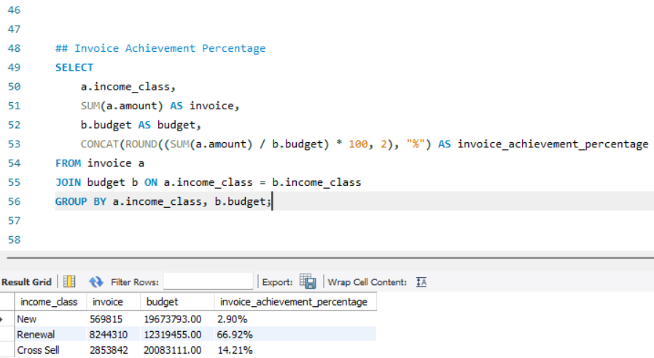
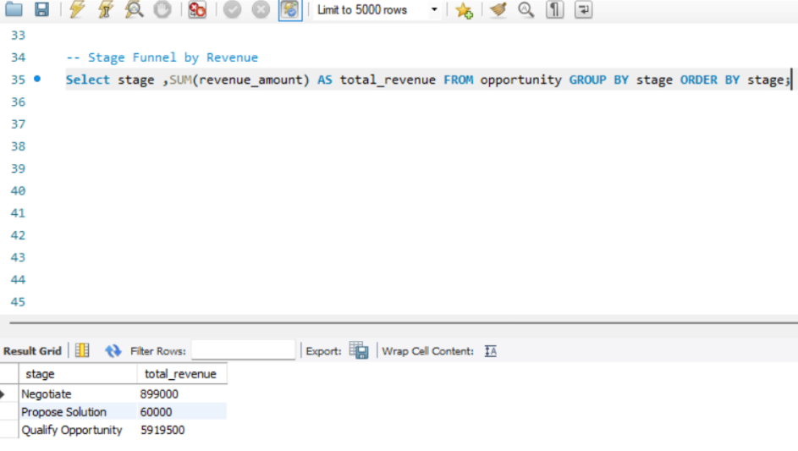
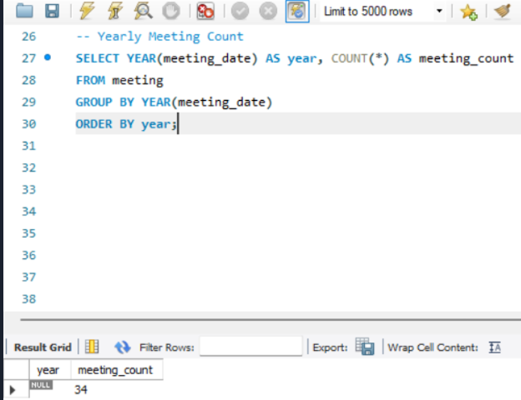
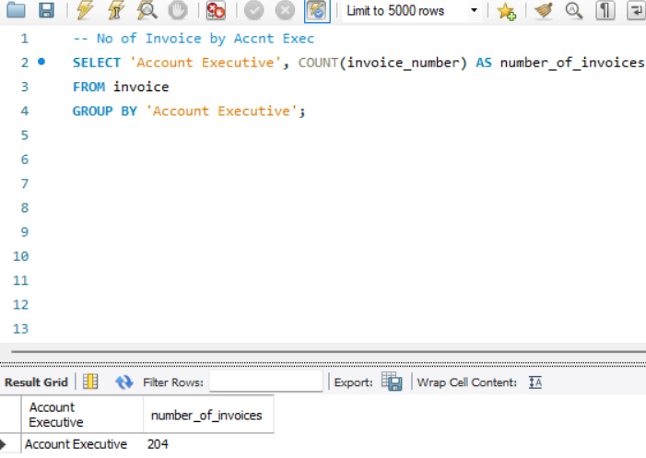
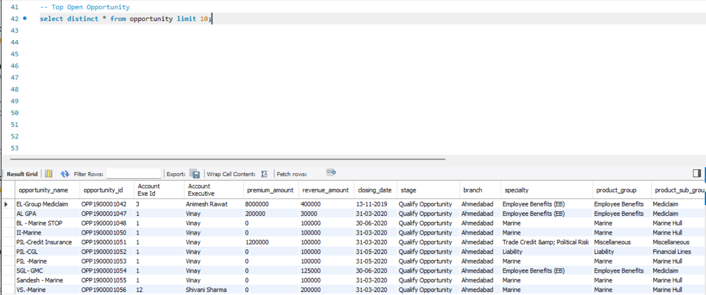
MYSQL queries

Slide 12
CONCLUSION
This Weekly Branch Dashboard provides insights into insurance sales performance, tracking Cross-Sell, New Business, and Renewals. Renewals exceed targets (150.23%), showing strong customer retention, while Cross-Sell (64.94%) and New Business (17.95%) need improvement. Invoice achievement is low, impacting revenue realization. Top revenue opportunities include Fire and Group Medical Insurance. Account Executives' performance is analyzed, highlighting engagement levels. Key actions: improve sales conversions, increase invoicing efficiency, and focus on high-value products. This dashboard helps optimize strategies, enhance productivity, and drive business growth.

Slide 13

Thank You

